Slide 1
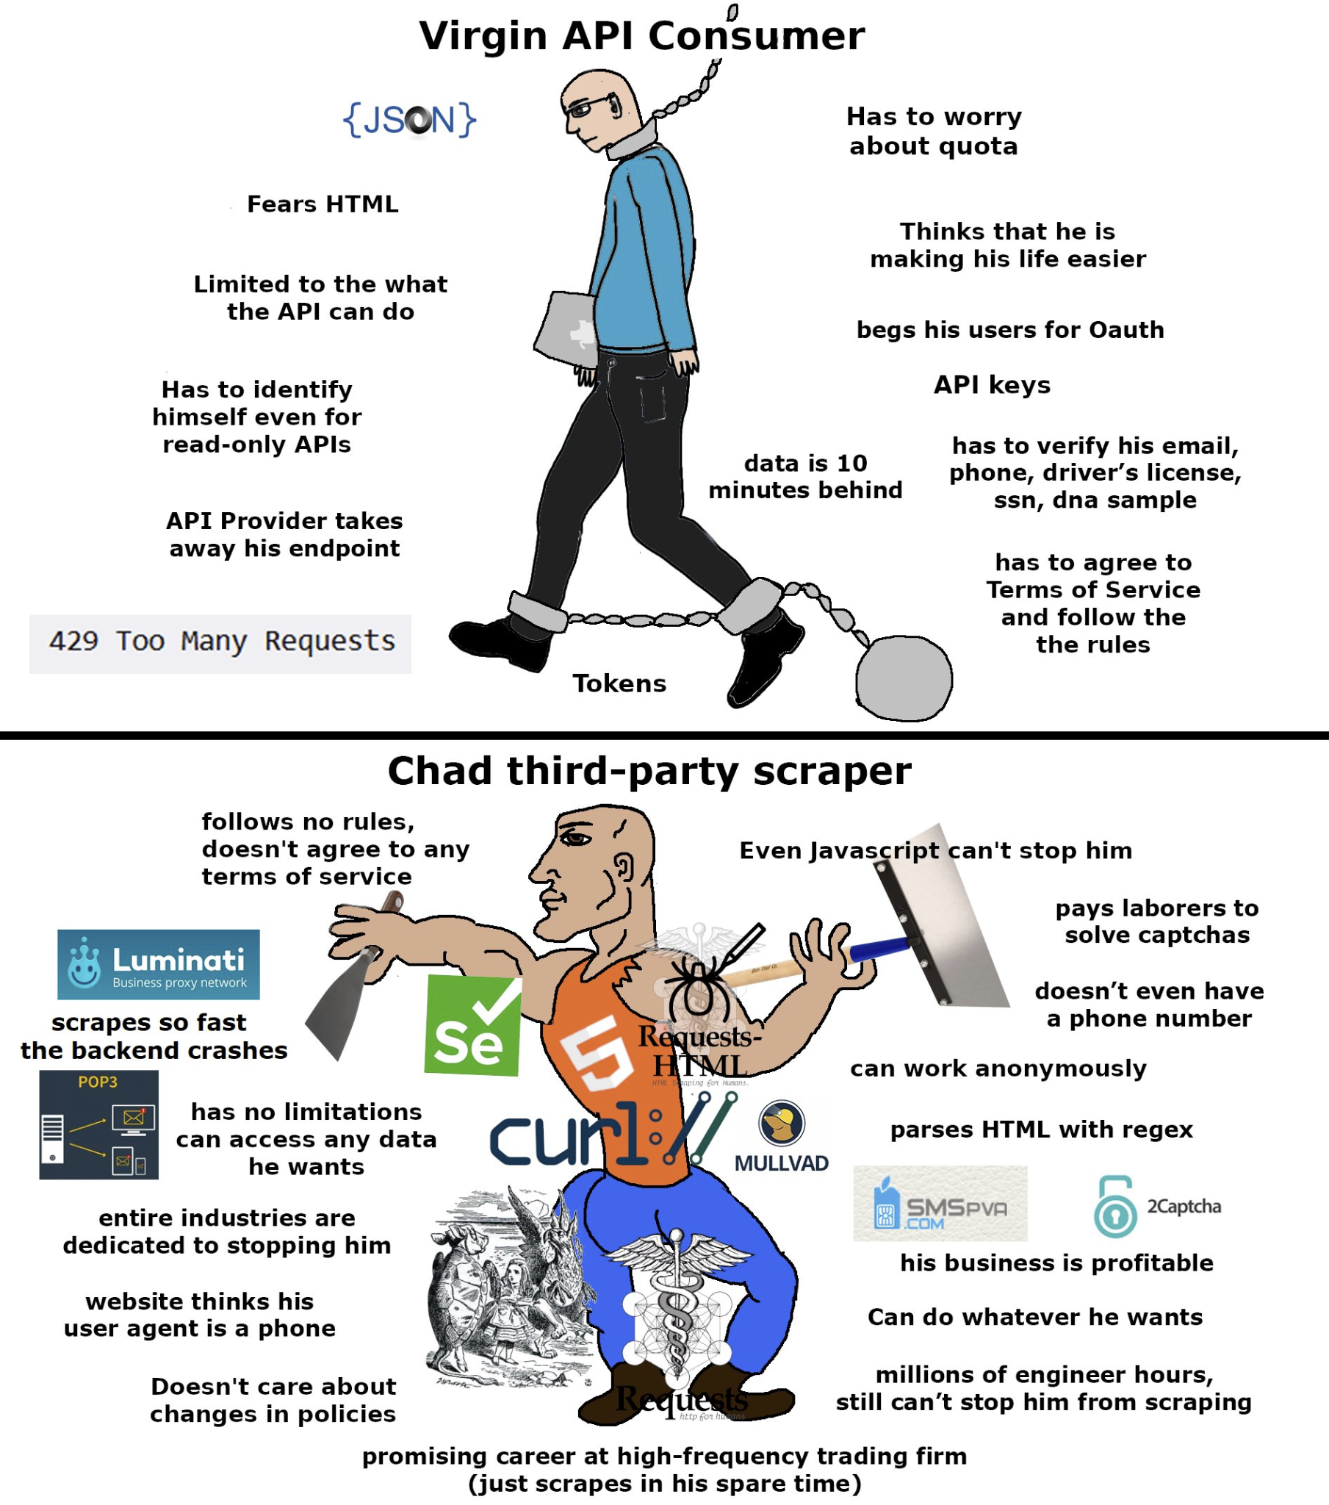
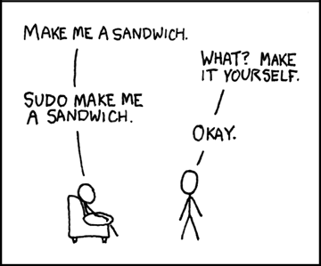
COMP2041
Week 4

Slide 2
Announcements
Welcome to Week 4 of COMP2041
Lab 3 due Monday 12PM AEDT
Week 03 Weekly Test due Thursday 9PM AEDT
Assignment 1 hasn’t been released yet? Idk but I do believe Dylan will release it soon hopefully
No idea about help sessions, but should be starting when assignments are released
Schedule released via email
Caution: Always very busy during assignment time, arrive early

Slide 3
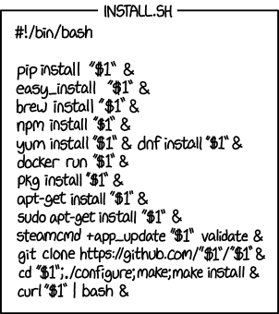
Overview
No new real content
case, read, function
Tutorial Questions

Slide 4

read
Reads from input.
read –p
while read line
Examples -

Slide 5

case
Simplifying if / elif / else statements
Examples -

Slide 6
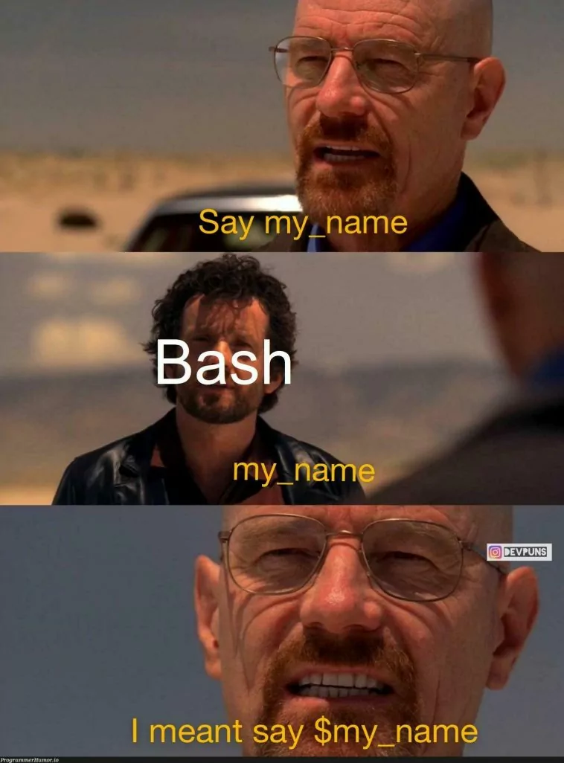

function
Helps us encapsulate reusable blocks of code, making scripts more modular and easier to maintain. (Basically the same thing from what we’ve been doing so far)
Examples -

Slide 7
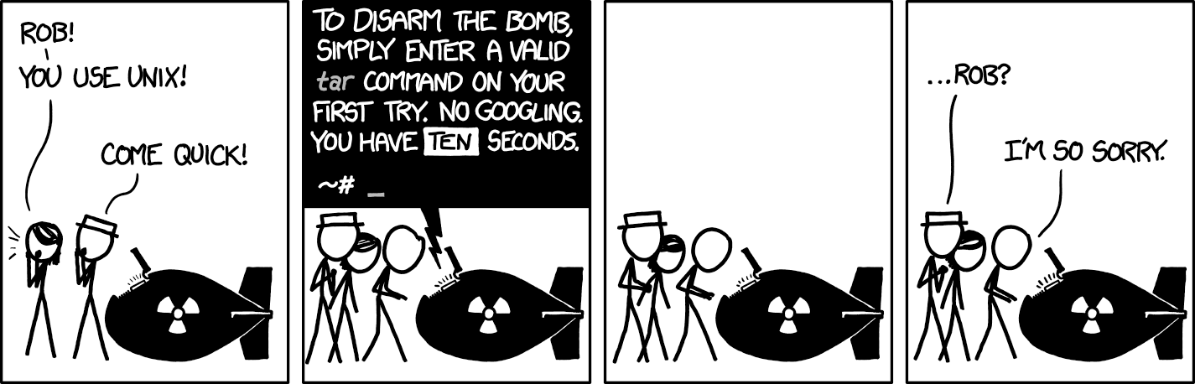
Tutorial Questions

Slide 8

To The
Lab!

